Slide 1


Key Determinants of Yelp Business Success: A Correlational Study
Discover the factors that contribute to business success on Yelp with our comprehensive study. Gain valuable insights into user preferences and perceptions.

Slide 2
Objective & Goals
Our objective is to present the findings of our study on the key determinants of Yelp business success. We aim to provide valuable insights and actionable recommendations to help businesses improve their performance on the platform.
The goals of this presentation are as follows:
Introduce the audience to the data we collected and the methodology used in our study.
Conduct an in-depth exploratory data analysis to identify the factors that strongly correlate with business success on Yelp.
Showcase visually compelling and informative visualizations to effectively communicate our findings.
Highlight the progress of our dashboard development, which will provide businesses with an interactive tool to analyze their performance on Yelp.
To help the users to find a restaurant in a particular city based on the reviews and restaurant rating

Slide 3
Intro on Data
This dataset is a subset of Yelp's businesses, reviews, and user data. It was originally put together for the Yelp Dataset Challenge which is a chance for students to conduct research or analysis on Yelp's data and share their discoveries. In the dataset you'll find information about businesses across 11 metropolitan areas in four countries.
In total, there are :
5,200,000 user reviews

Slide 4
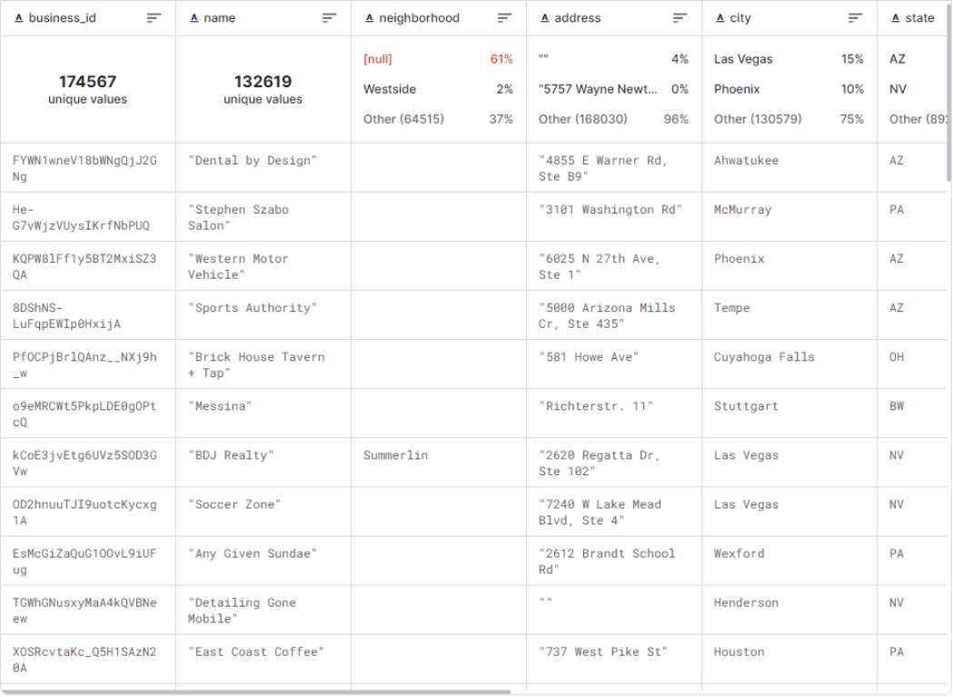
Business

Slide 5
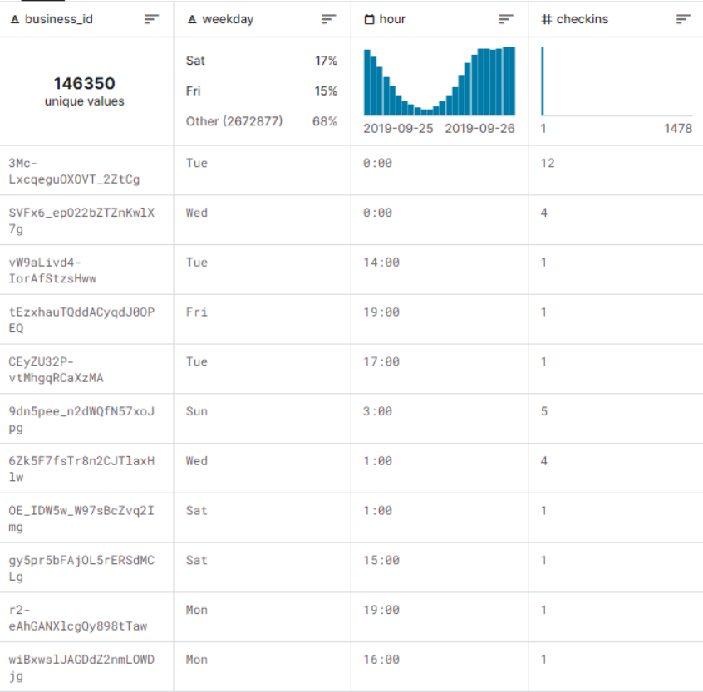
Check Ins

Slide 6
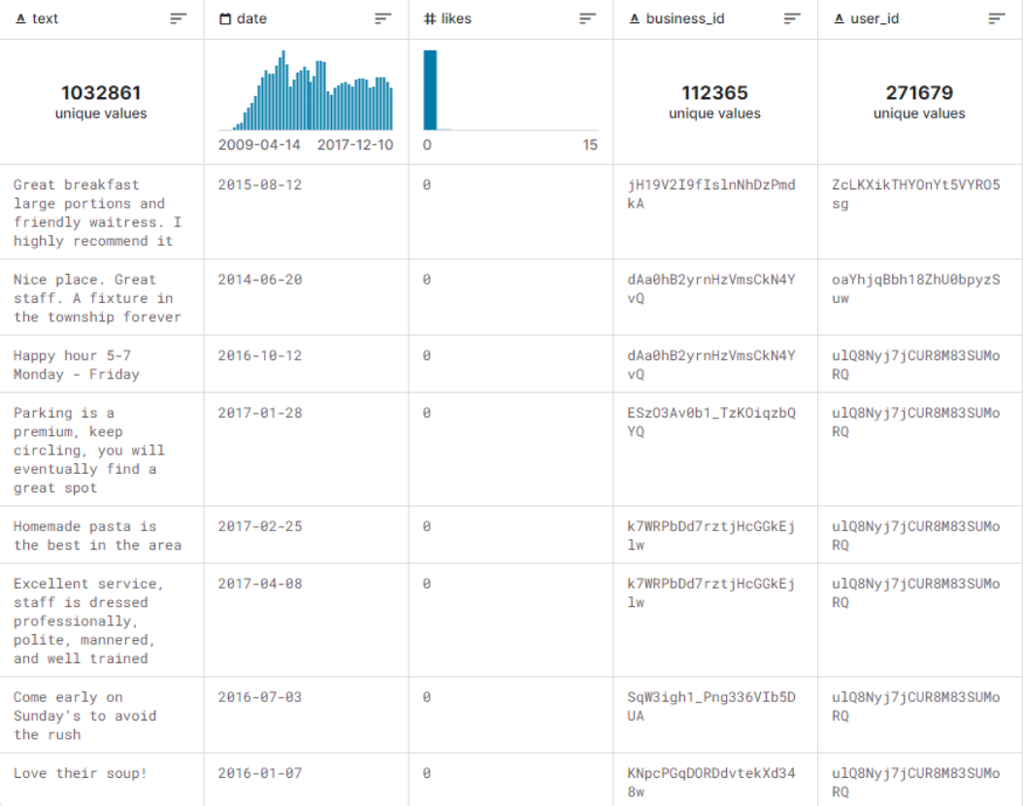
Tips

Slide 7
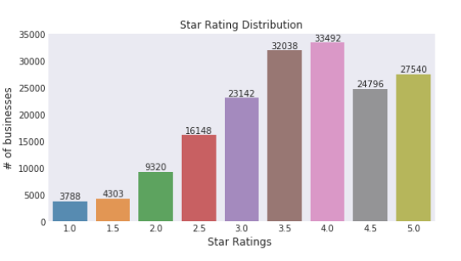
EDA
Handling Missing Values: Delete or impute missing data.
Removing Duplicates: Identify and eliminate duplicate entries or rows.
Handling Outliers: Remove or replace outliers using statistical methods.
Data Cleaning Techniques: Standardize, handle inconsistencies, deal with irrelevant data, handle skewed data, encode categorical data, handle inconsistent data entry, and address data type incompatibilities.

Slide 8
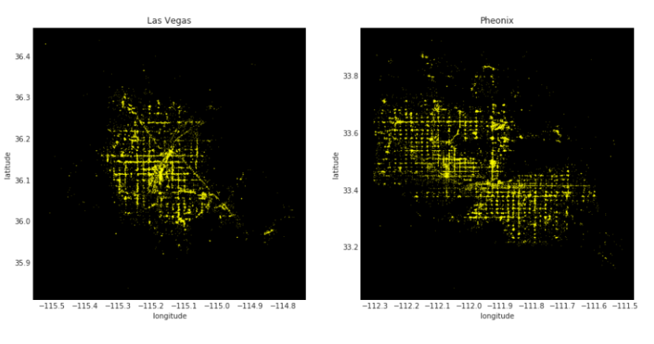
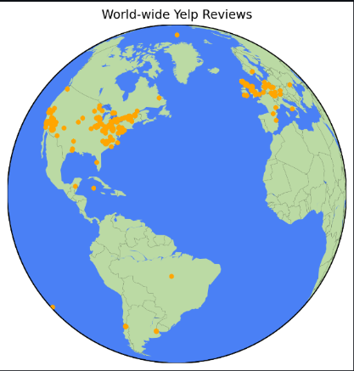
Visualizations

Slide 9
Layout of Dashboard
Overall - Provides overview of the yelp Dataset coverage.
Rating - Provides city wise rating of the restaurants
Sentimental Analysis - Provides overview of reviews on a single restaurant.

Slide 10

Demo

Slide 11
Results & Conclusion
After conducting an in-depth analysis of the data and implementing the project using Streamlit, we have arrived at several key findings:
Businesses that have a higher average rating on Yelp tend to have better overall performance and higher customer satisfaction.
The number of reviews a business receives is positively correlated with its success, indicating that customer engagement and feedback play a crucial role.
In conclusion, our study highlights the importance of various factors in determining Yelp business success. By leveraging the insights gained from our analysis, businesses can optimize their strategies and improve their performance on the platform.
We implemented the project using Streamlit, a powerful and user-friendly framework for building data-driven applications. Through the Streamlit dashboard, businesses can easily access and visualize their performance metrics, identify areas for improvement, and make data-informed decisions.

Slide 12
Questions ?

Slide 13
Thank you

